Slide 1
Grammars
A formal grammar G is any compact, precise mathematical definition of a language L.
A grammar implies an algorithm that would generate all legal sentences of the language.
Often, it takes the form of a set of recursive definitions.
A set of rules for generating syntactically correct statements for a given language.

Slide 2
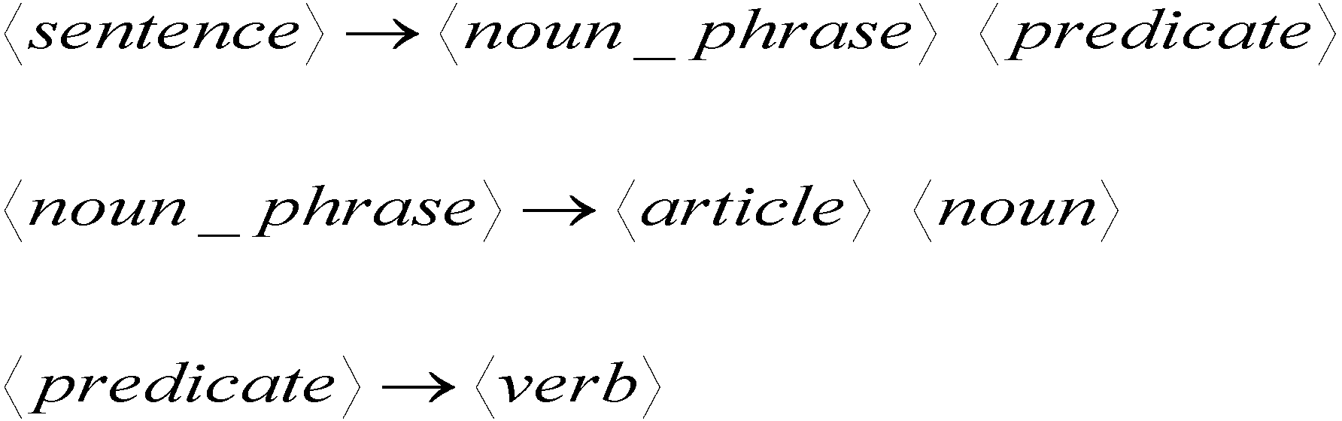
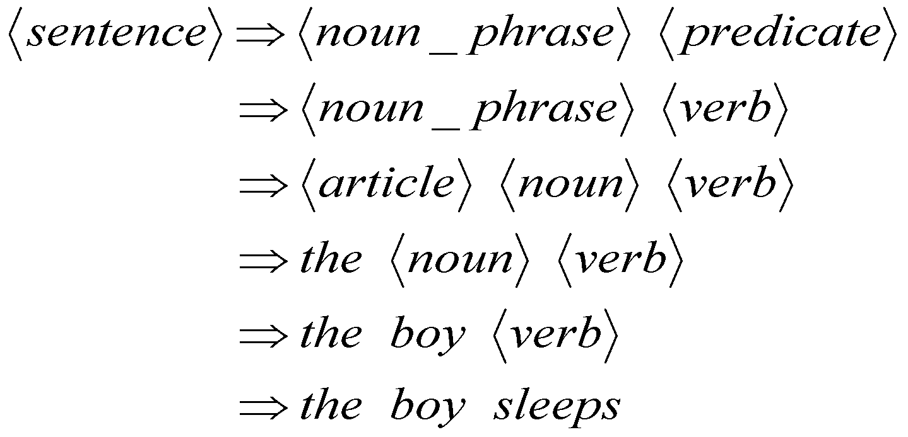
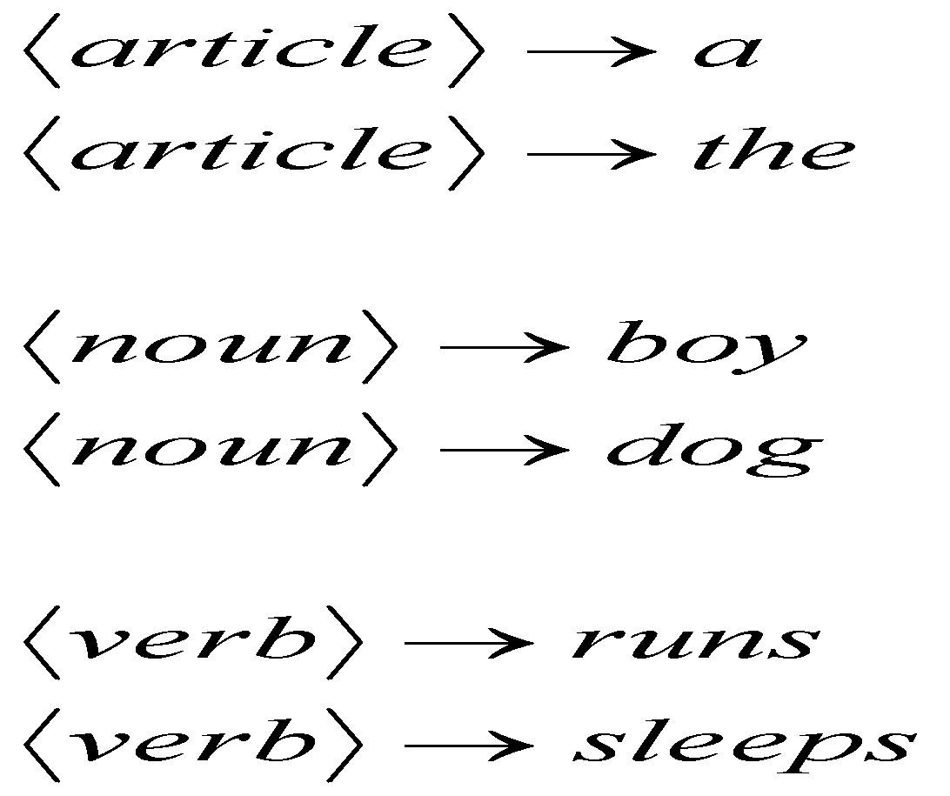
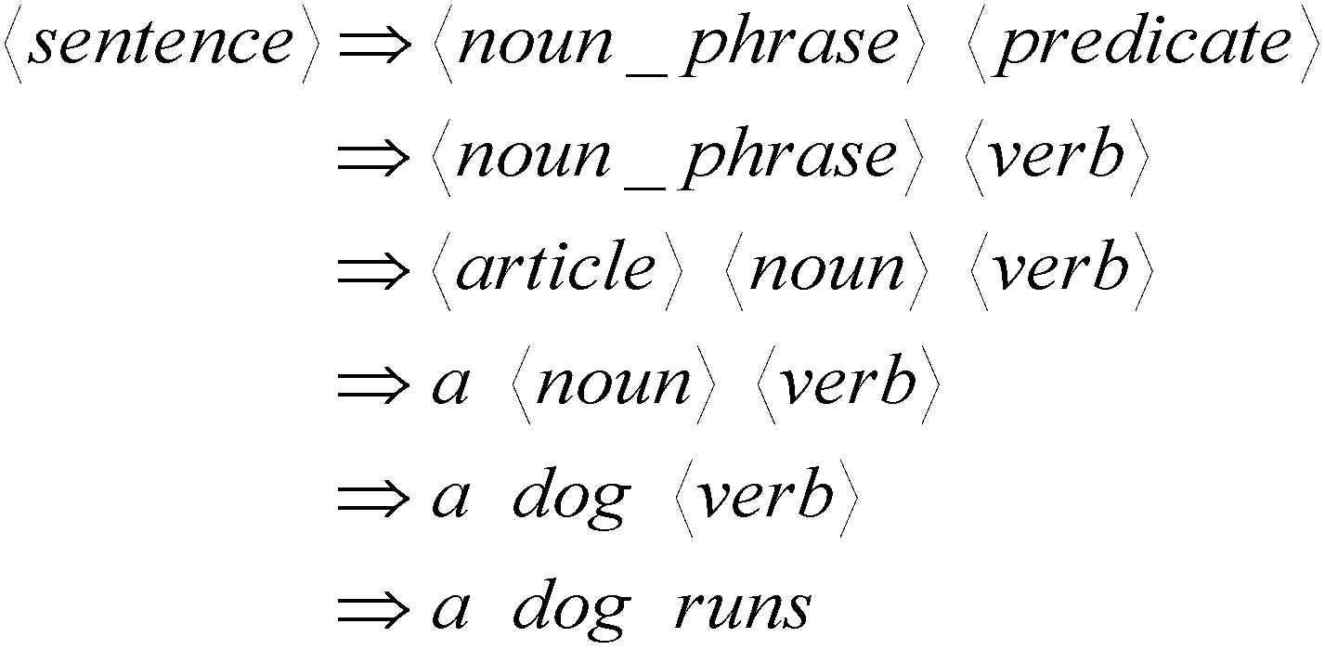
Example: A grammar that generates a subset of the English language
A derivation of “the boy sleeps”:
Language of the grammar:
A derivation of “a dog runs”:
L = { “a boy runs”,
“a boy sleeps”,
“the boy runs”,
“the boy sleeps”,
“a dog runs”,
“a dog sleeps”,
“the dog runs”,
“the dog sleeps” }
‹#›

Slide 3
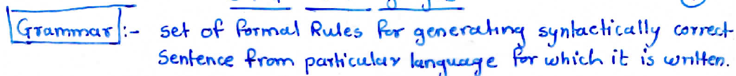
Grammar
Grammar defines syntax of a language.
Grammar Constituents:
Terminal Symbols: Constituents of a generated sentence
Non-Terminal Symbols: symbols that take part in the generation of sentence but are not part of generated sentence.
Production Rules: Rules of the grammar.

Slide 4
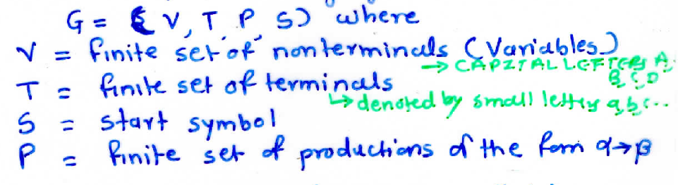
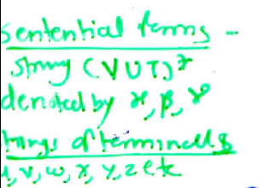
Formal Defination of Grammar

Slide 5
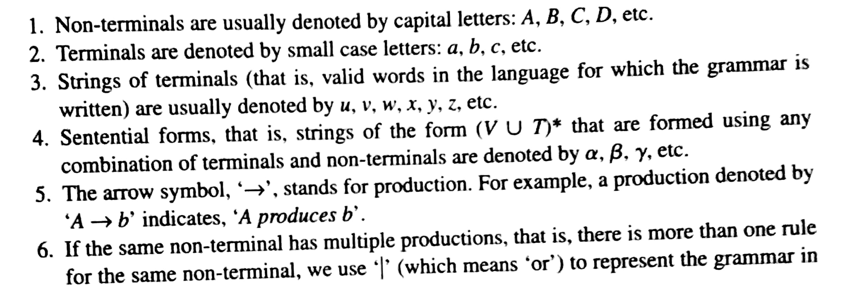
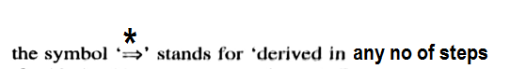
Grammar Notations

Slide 6
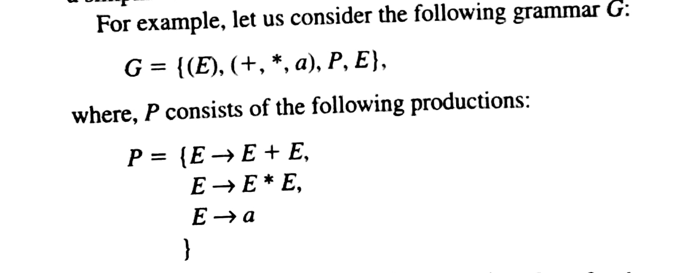
Example
G=(V, T,P,S)

Slide 7
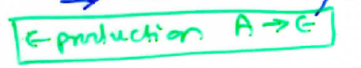
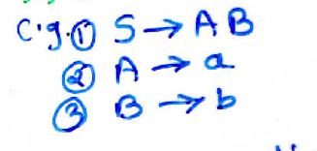
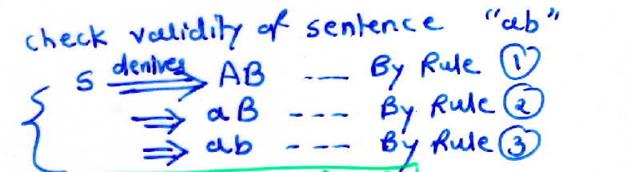
Example
G=(V, T,P,S)

Slide 8
Derivation Types - Leftmost - Rightmost

Slide 9

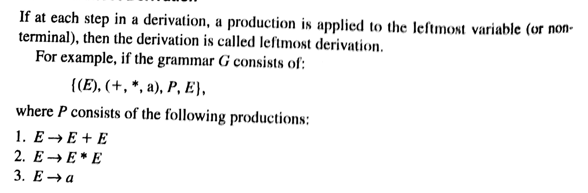
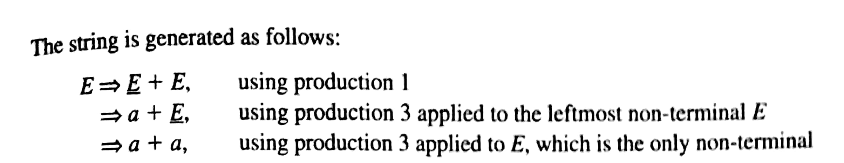
Derivation Process

Slide 10

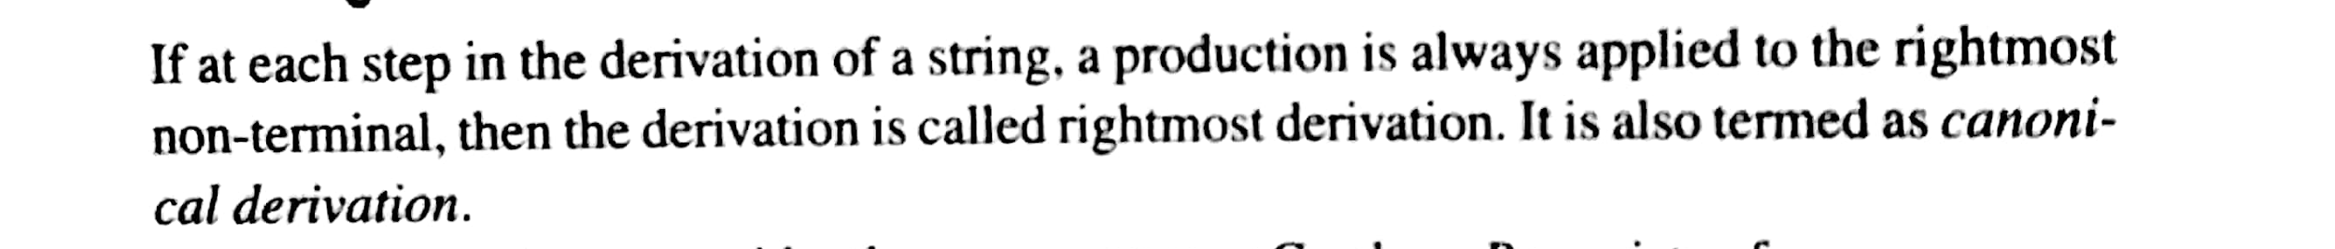
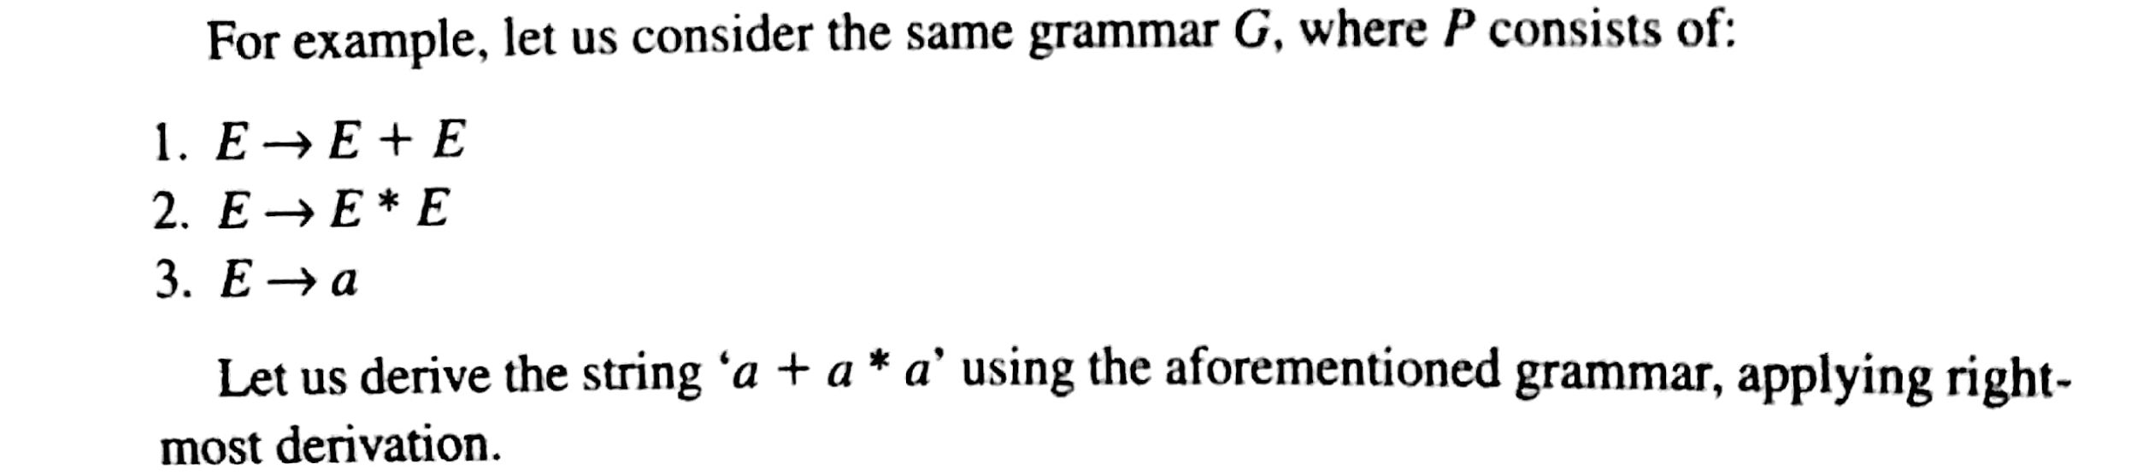

Slide 11
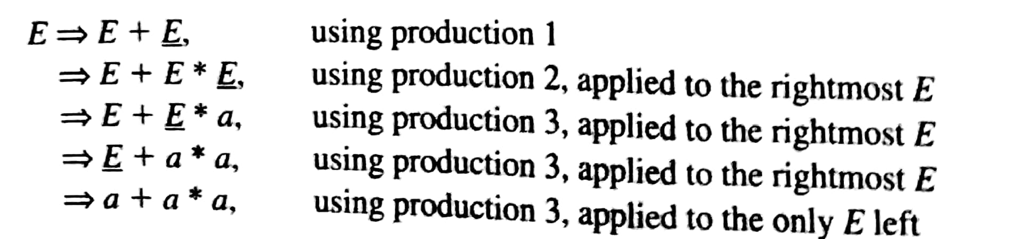

Slide 12
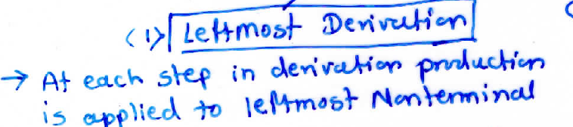
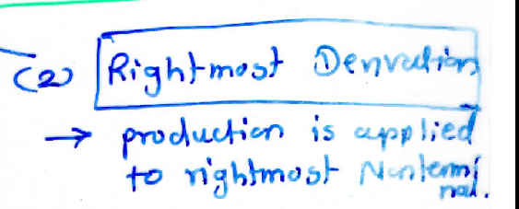
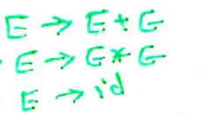
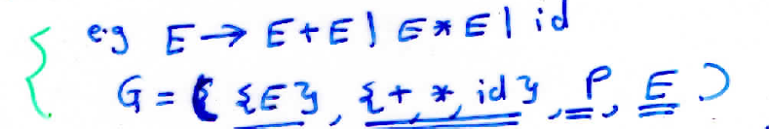
Derivation Types

Slide 13
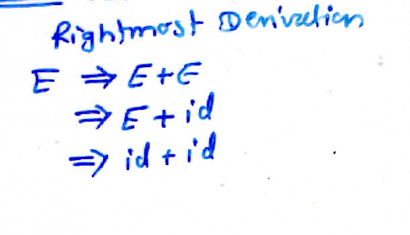
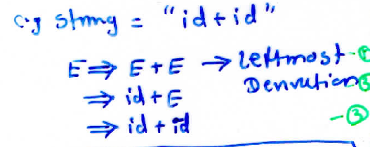
Derivation Types
1.
2.
3.

Slide 14
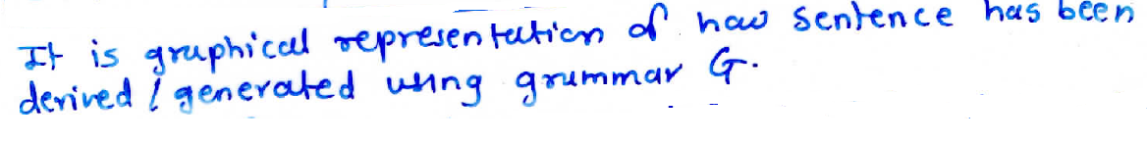
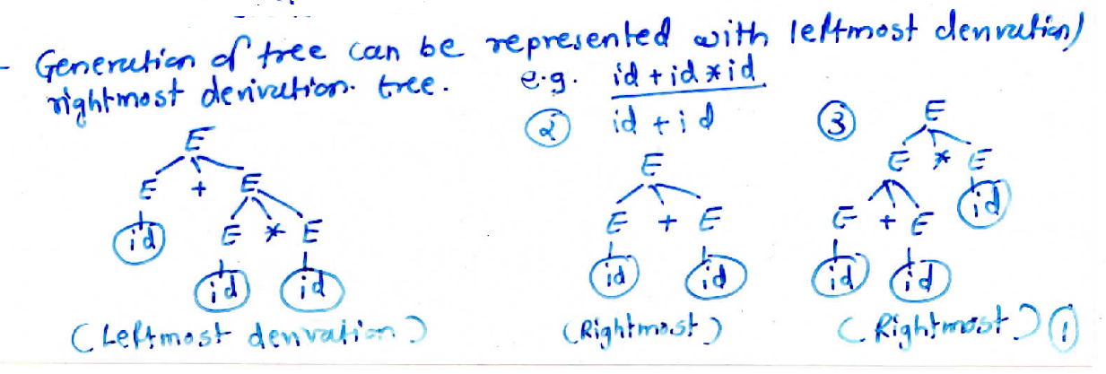
Derivation Tree/ Parse Tree
1.
2.
3.

Slide 15
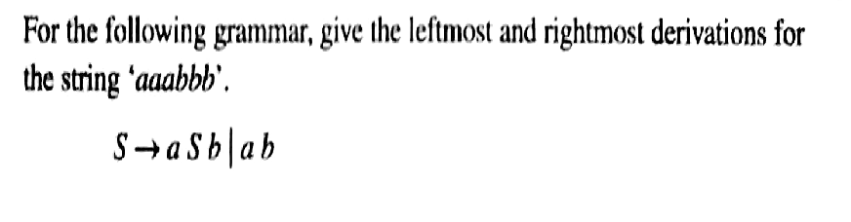
Example1

Slide 16
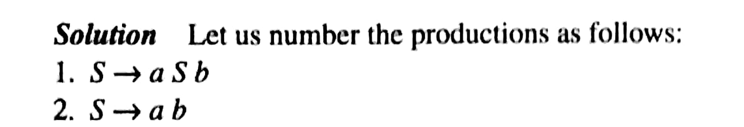
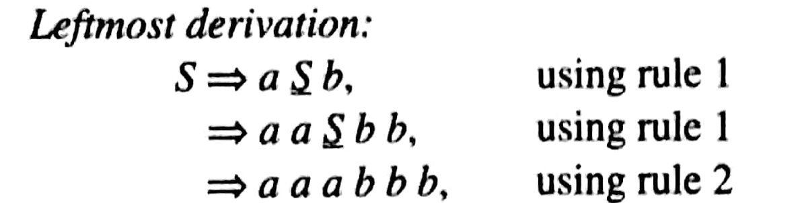
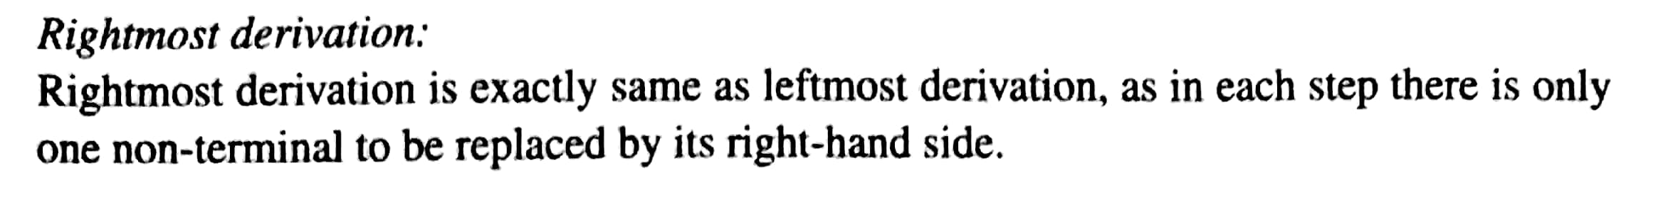
Example1

Slide 17
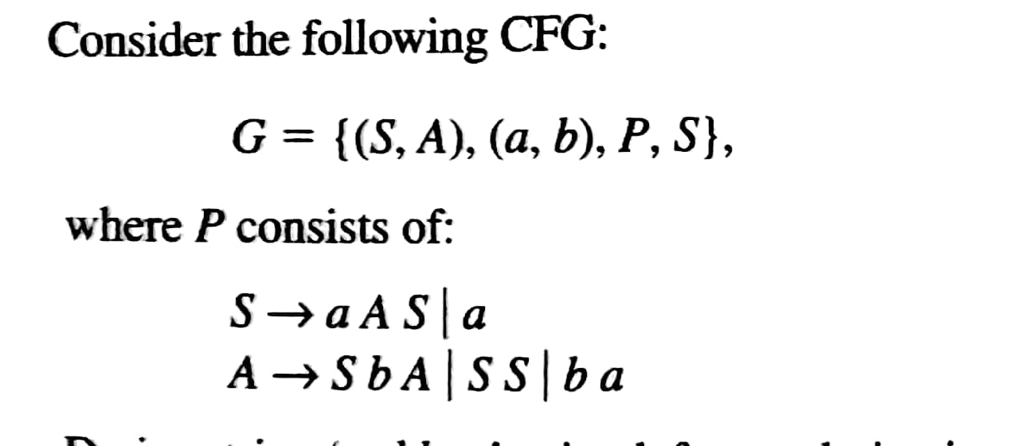
Example 2

Slide 18
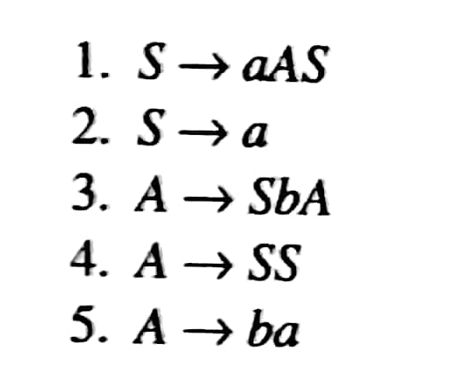
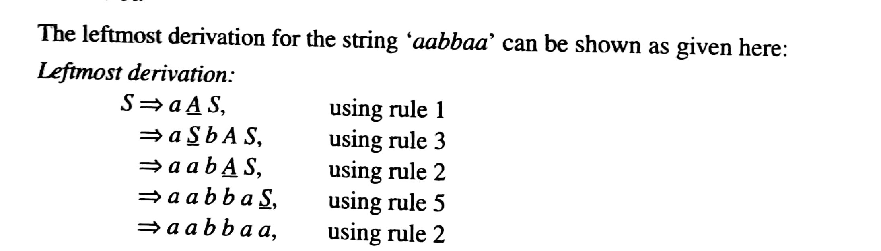
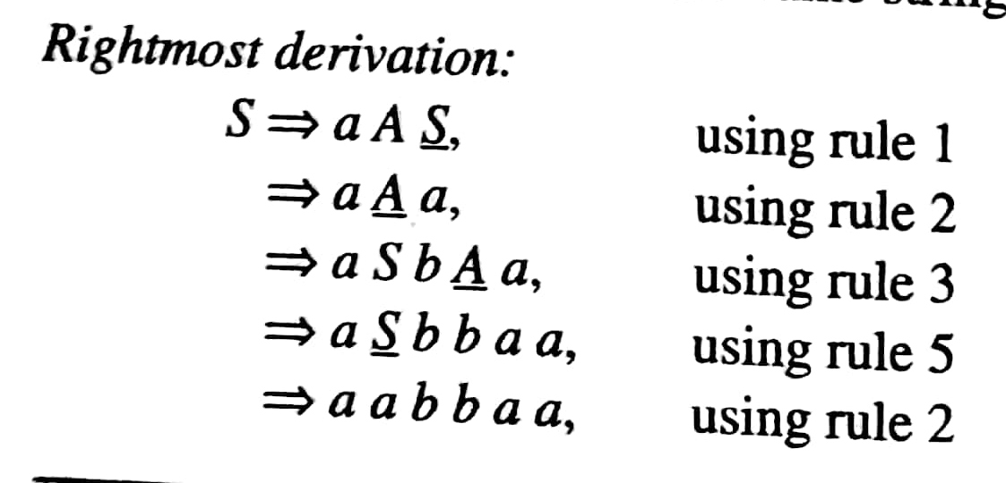
Example 2

Slide 19


Slide 20
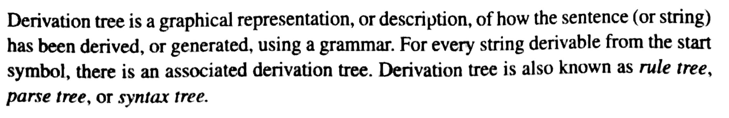

Slide 21
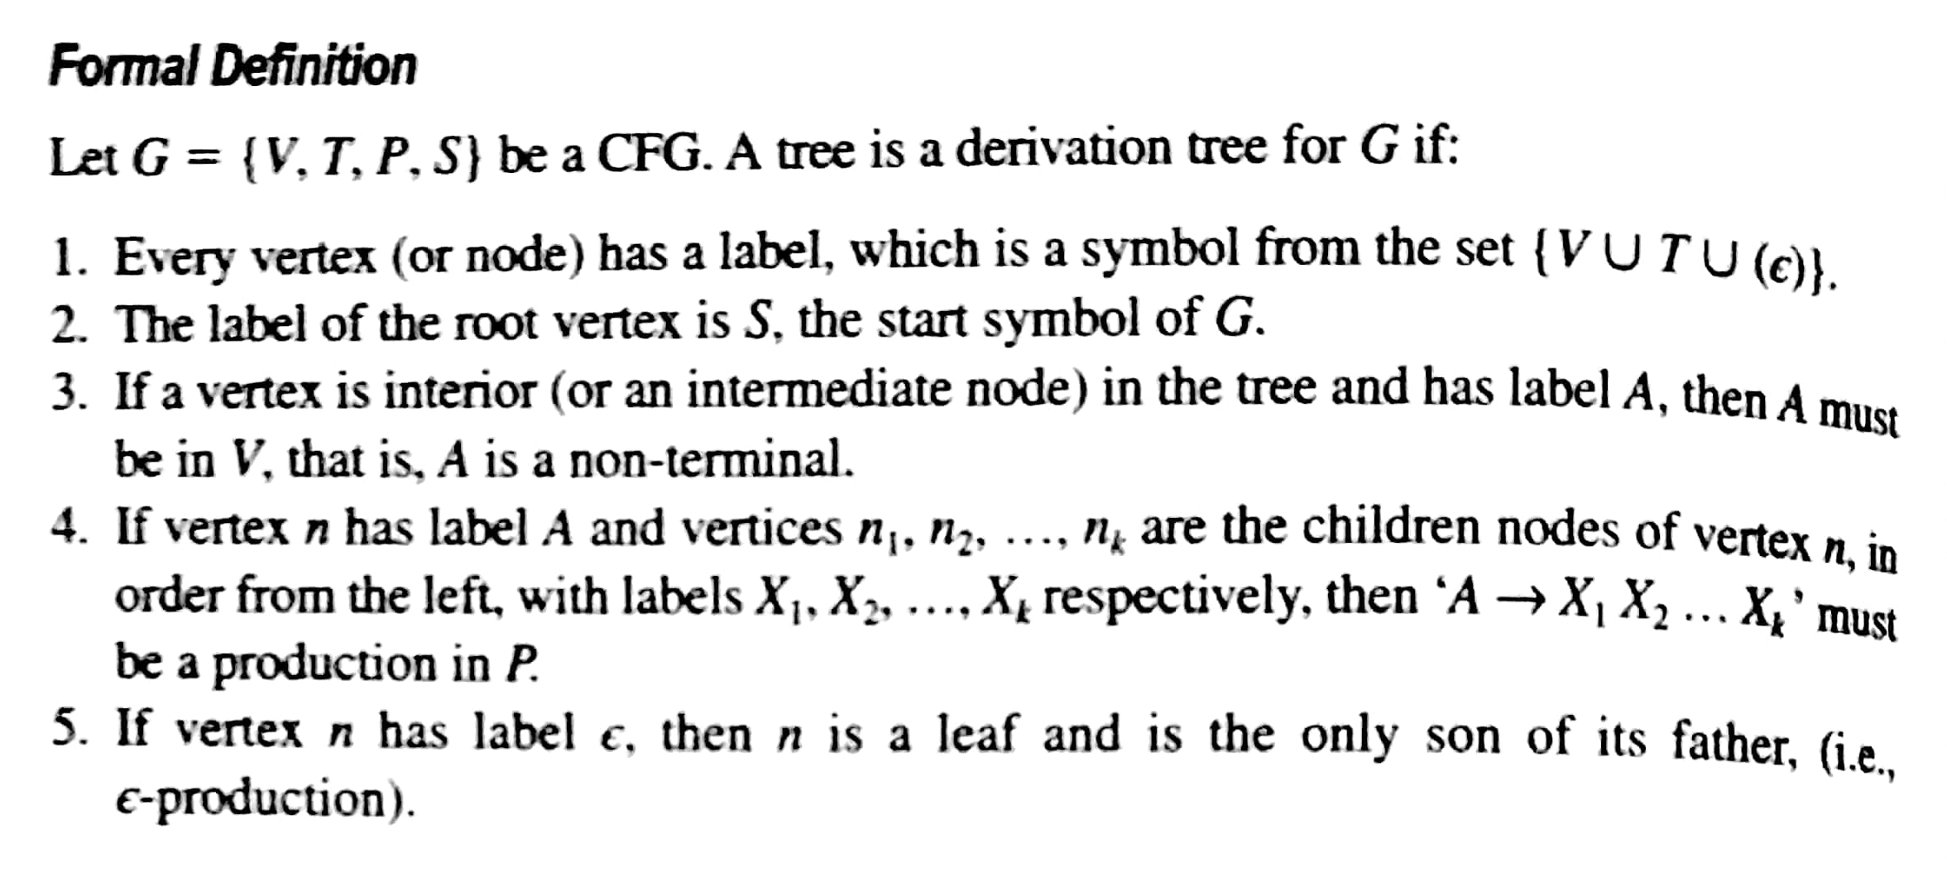

Slide 22
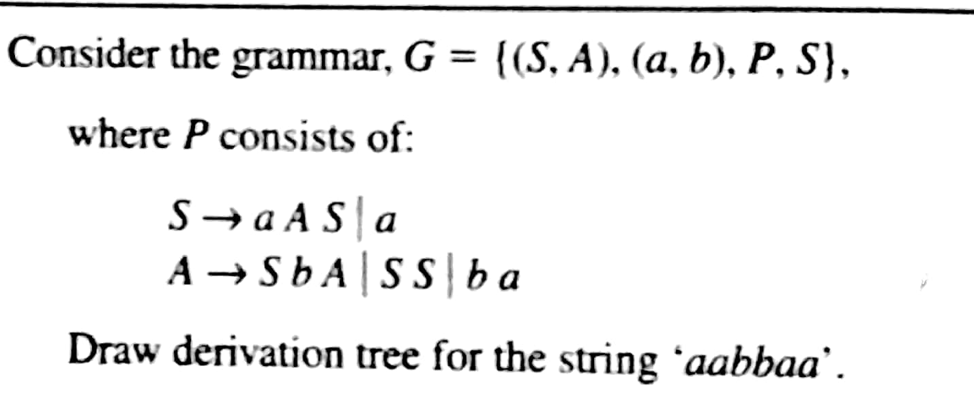

Slide 23
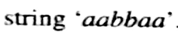
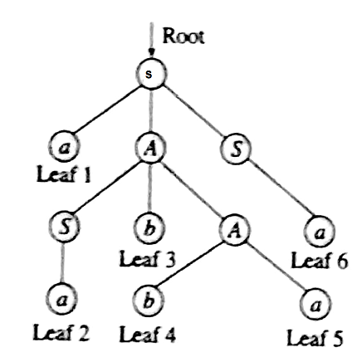
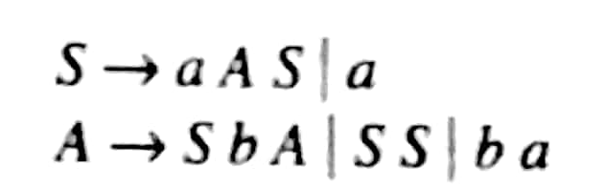

Slide 24
Types of Grammars - Chomsky hierarchy of languages
Venn Diagram of Grammar Types:
Type 0 – Phrase-structure Grammars
Type 1 – Context-Sensitive
Type 2 – Context-Free
Type 3 – Regular

Slide 25

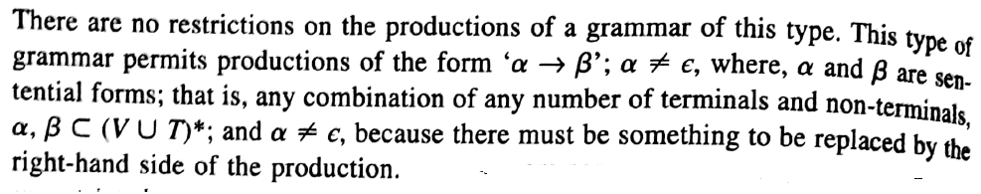

Slide 26
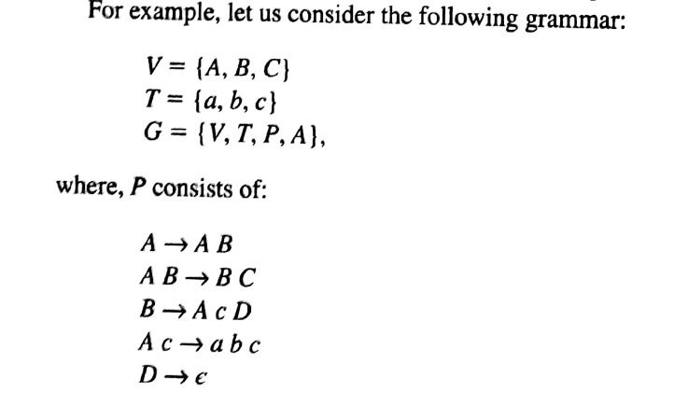

Slide 27
Type O grammar generate all the languages that are accepted by Turing Machines
Turing machine accepts recursively enumerable languages.

Slide 28
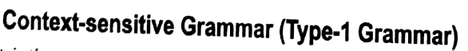
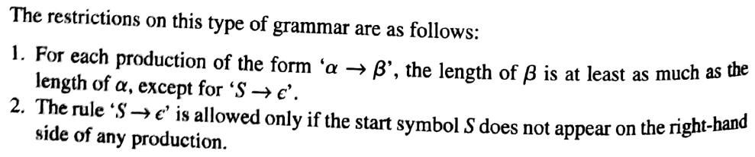
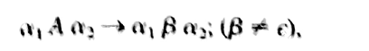

Slide 29
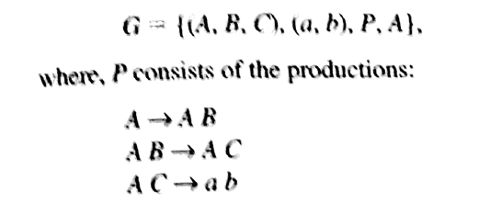

Slide 30
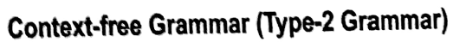
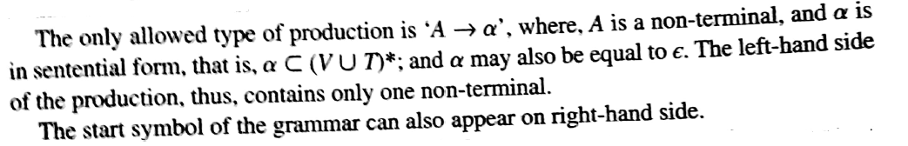

Slide 31
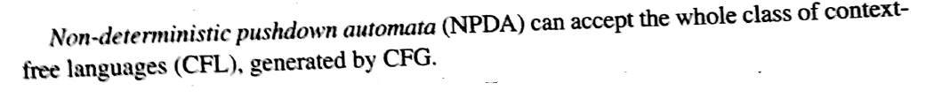

Slide 32
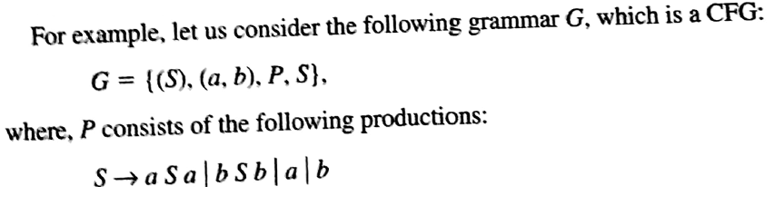

Slide 33



Slide 34
Regular Grammar can be
1. Left Linear Regular Grammar
2. Right Linear Regular Grammar

Slide 35


Slide 36


Slide 37


Identify Type of Grammar and Language Generated by it?

